Slide 1
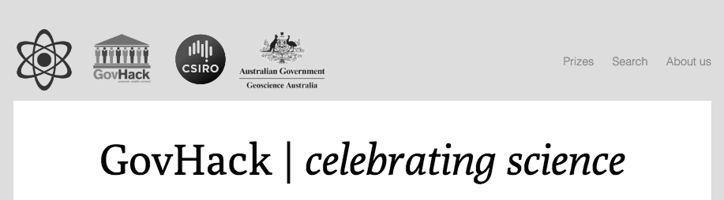
GovHack Discoverability Hack
Starting point
http://govhack-science.github.io/ is awesome.
It combines themes and categories, with prizes, datasets, mentors, and
tips for developers – all in a contextually aware fashion.
How do we scale this to the whole of GovHack?
Notes:
Everything is interlinked!

Slide 2
GovHack Discoverability Hack
The situation in 2015
15,000+ open government datasets in Australia (conservative estimate)
350 official datasets/portals/catalogues submitted by sponsors (That’s 19 pages long if you printed it!)
14 official government data catalogues (+ More domain-specific catalogues)
24 National & international prizes (+ Many many state & local prizes)
30 national sponsors
41 mentors

Slide 3
GovHack Discoverability Hack
Hackers currently find data by -
Agencies and sponsors submitting it directly to GH as an “official datasets”
Hosted on agency websites; or
Official open data portals
Trawling for data on the official government open data portals
Mentors on-site at events
Desperate Googling!
And they’re usually doing so in a rush.

Slide 4
GovHack Discoverability Hack
GovHack 2015 Survey Results
A few thoughts about data...
“A broad list of other datasets available with a quick descriptions for cross referencing with the 'promoted' datasets provided by sponsors.”
“There were so many datasets to choose from; any more and brains would explode.”
“More fun data! And more clarity on what data goals would actually be helpful."

Slide 5
GovHack Discoverability Hack
So, how can we -
Make it easier to explore and discover the thousands of open datasets that are out there? (Across three levels of government and two countries.)
Better align govhack.org with how hackers actually think about their projects and approach finding data?
More closely align with the competition structure and provide sponsors more exposure?

Slide 6
GovHack Discoverability Hack
What if -
You could choose how you explored GovHack and everything was linked together?
Existing
New
Datasets
Prizes
Organisations
Mentors
Themes
Locations
Data Portals
Challenges
Notes:
Themes could be broad – like science, community, et cetera - or a means for us to highlight something special – like fun datasets.

Slide 7
GovHack Discoverability Hack
What if -
You could explore by broad themes, see the prizes and organisations involved, then click on a mentor and see more info about them, including the fields and other areas they can mentor for.
Or, you could look at a prize, see the sponsoring organisations, related themes, see the datasets involved, and click through to the organisation to see the rest of their data, their mentors, and the fields they’re involved in.
And what if we had serving suggestions, links to data portals, and curated sets of government data linked throughout?
Notes:
Curated links to govt data portals to uncover data related to a theme (e.g. search for particular tags, group, terms, whatever. Could be several per-category.)
Curated Google searches to uncover unlisted government data.

Slide 8
GovHack Discoverability Hack
Demo time!
http://govhackaustralia.github.io
Notes:
Navigation is easy, friendly, and modern - ”How do you want to explore GovHack?”
Backwards compatible – you can still just see a list of prizes, official datasets, or mentors.

Slide 9
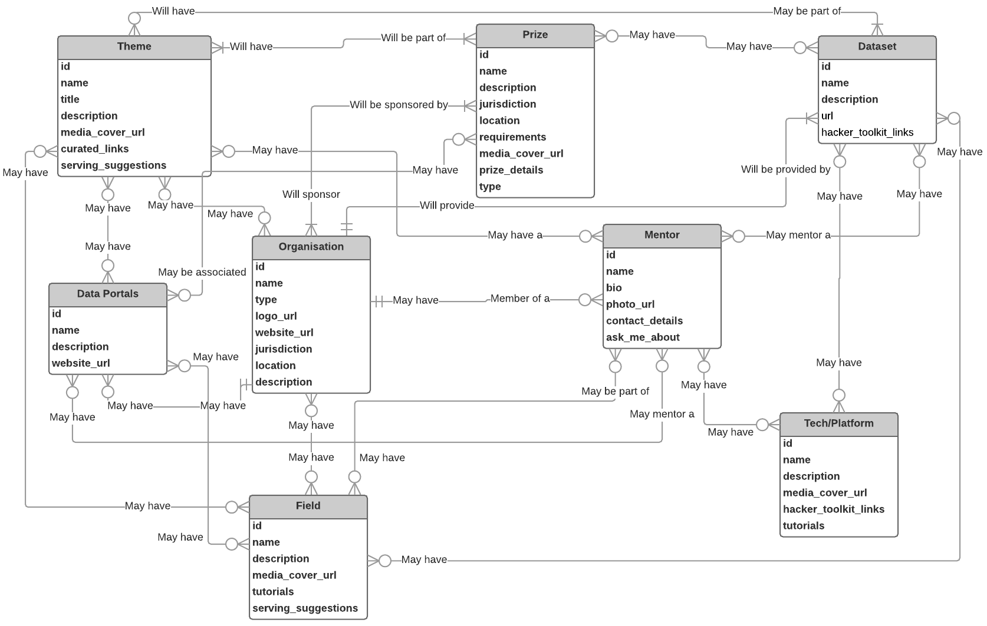
GovHack Discoverability Hack

Slide 10
GovHack Discoverability Hack
Plan & Timeline
March
27th: Proof of Concept Completed
April
6th: POC Acceptance by GOT
15th: Validation Completed
17th: Workflow Documented Begin Alpha Development
20th: Workflow Accepted by GOT
24th: Alpha Release Completed Begin Alpha Testing
May
6th: Alpha Testing Complete
15th: Beta Release Completed Content Populated (Mostly) Public Beta Testing Begins
June
5th: Public Beta Testing Completed
26th: Content Finalised
26th: Public Release
July
Throughout: Inevitable bug fixing and tweaks to content
29th: Prizes go live!
Notes:
Validation: Reference group of former participants and mentors.

Slide 11
GovHack Discoverability Hack
Up in the air
New Zealand – Doing their own thing or should we include?
How tightly integrated is the Hacker Toolkit this year?
Do we need to give special consideration to corporate data?
How deep do we go to expose all government data? (Not just the “official datasets”). (See survey results!)
Do we get fancy and integrate the CKAN API? (Maybe next year?)
Do we get fancy and tie it to the data/mentor submission forms?
Notes:
Hacker Toolkit: Could be linked in directly, but probably just links back to it for this year. Let's see if this is successful.
Corporate data: Not all datasets are government – increasingly we’re getting corporate data as well. (Not all corporates may wish it listed as “official data” to prevent confusion though.)
Exposing govt data: “A broad list of other datasets available with a quick descriptions for cross referencing with the 'promoted' datasets provided by sponsors.”

Slide 12
GovHack Discoverability Hack
Questions
How do people start their projects? What directions/angles?
How can we enhance the experience for mentors?
What were your pain points as a sponsoring agency? And as a mentor?
Can we use this to enable “Meet the data owners” events and pre-event info sessions?
What other ways would people want to explore? (e.g. By state or event location, ...)

